Slide 1
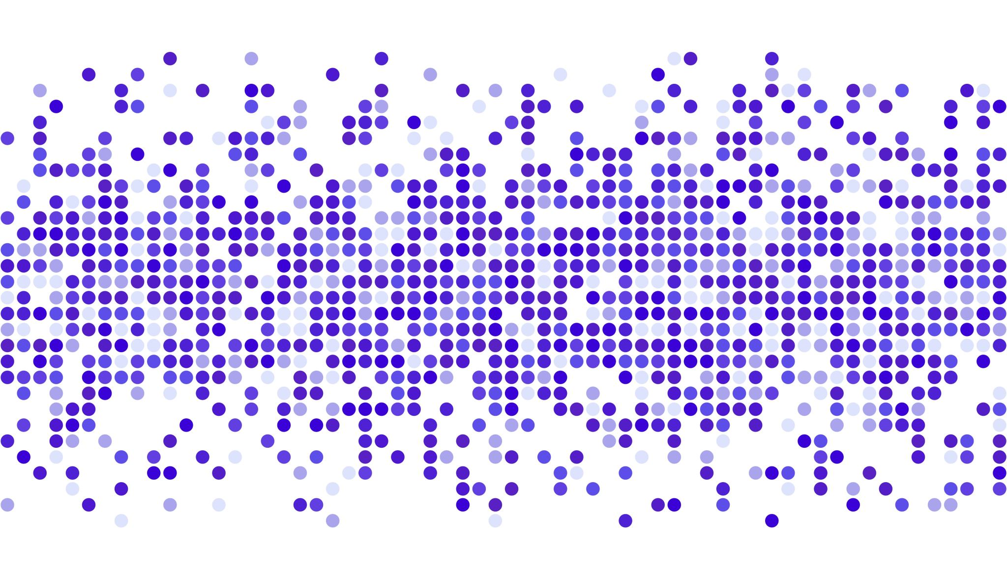
AIML CA2 Part B
LIM JUN YI
P2308924
DAAA/FT/1B/03

Slide 2
Aim of the assignment (Section B)
Group 1000 students into multiple clusters by using age, gender and subject
To cater to the needs for the different students
Perform Unsupervised Learning onto the dataset to look at how the different models are grouping the student clusters.

Slide 3
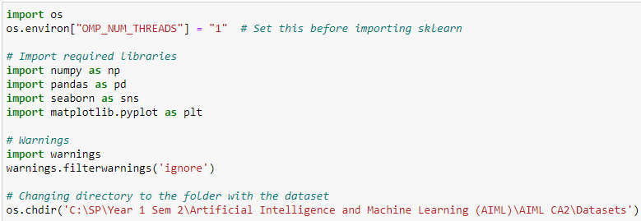
0. Importing required Functions

Slide 4
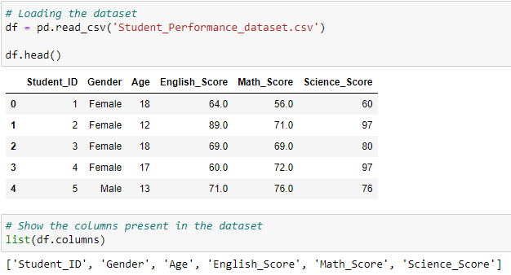
Loading the dataset
Loading the dataset
Display all columns in the dataset

Slide 5
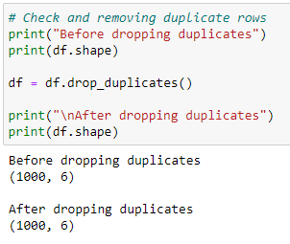
1. Preprocessing Check for duplicates
No duplicates found

Slide 6
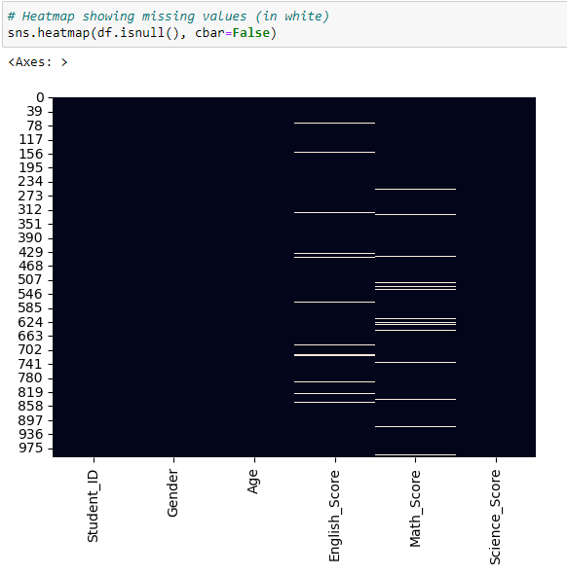
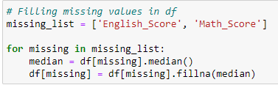
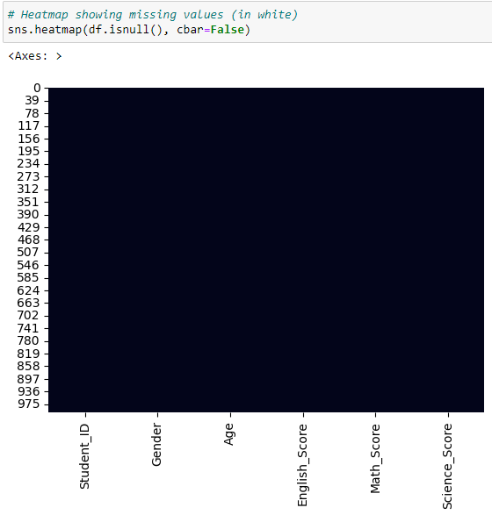
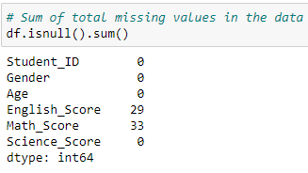
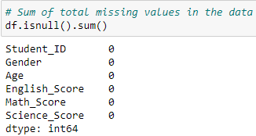
Check + Impute Missing Values
Impute by
median
White bars:
missing data
Double Check for missing data
Sum of missing data

Slide 7
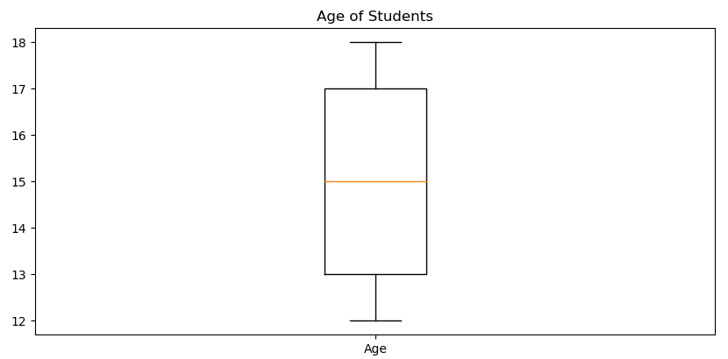
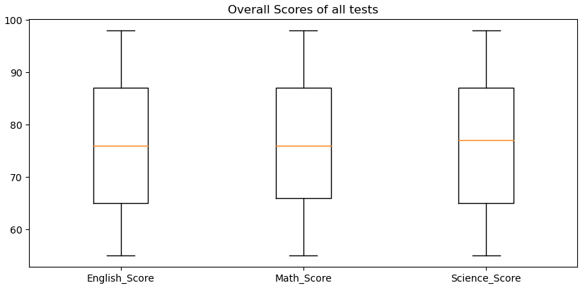
Check for outliers
Since there is no markers or points shown outside of the fences of the boxplots, there is no outliers present.

Slide 8
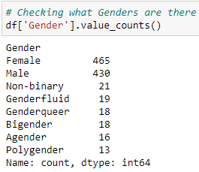
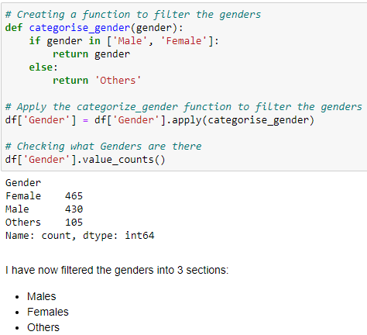
Reducing the ‘Gender’ column
Applying a function to put other genders into ‘Others’ column
→
It reduces the number of columns present in the dataset
→
Reduce the size of the dataset

Slide 9
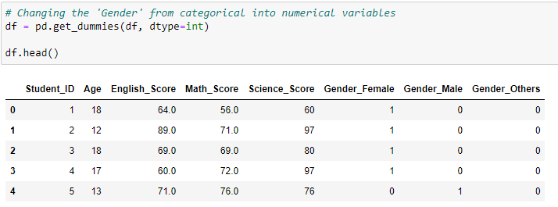
Creating dummy variables
Creating dummy variables for the ‘Gender’ columns to convert the categorical variables to numerical variables

Slide 10
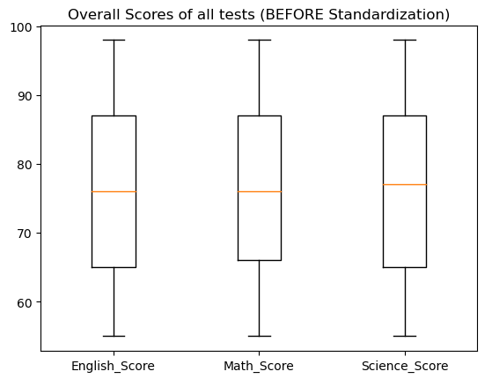
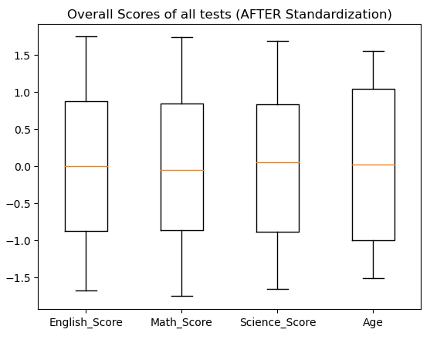
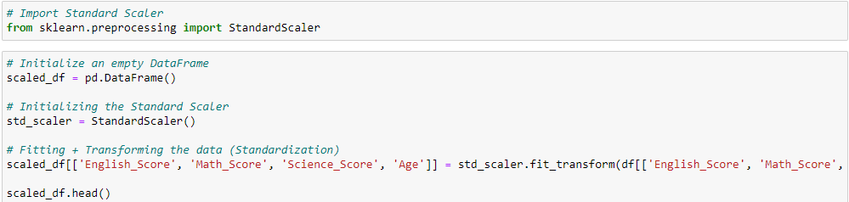
Standardization (Standard Scaling)
The data are all around the same variance
Standard scaling the data

Slide 11
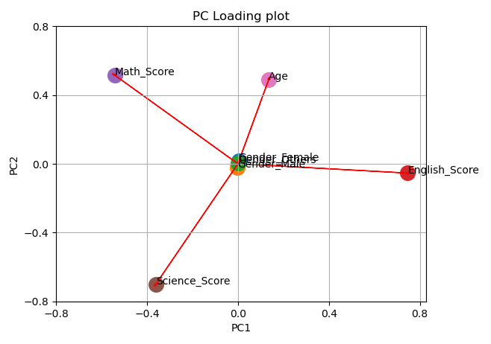
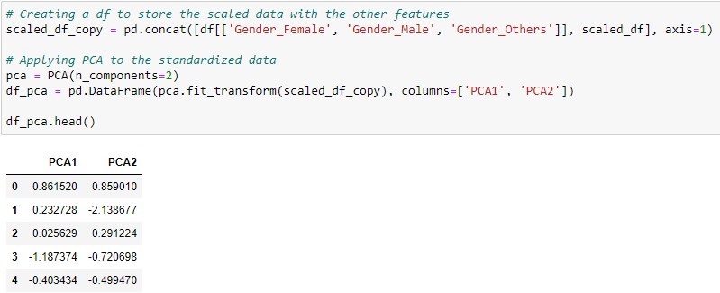
PCA
Creating PCA Variables (2 components)
PC1 is positively associated with English score & Age but is negatively associated with Science score and Math score.
PC2 is positively associated with Math score & Age while negatively associated with Science score.

Slide 12
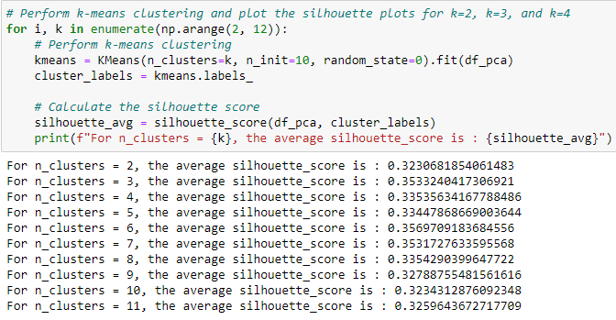
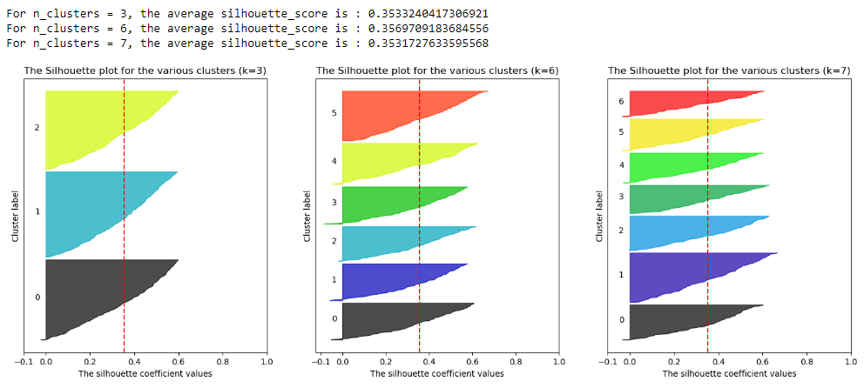
2. Model (Train & Test) KMeans
Highest Average Silhouette score for KMeans Clustering:
0.356 with 6 clusters
Visualizing the silhouette plots for the top 3 silhouette scores

Slide 13
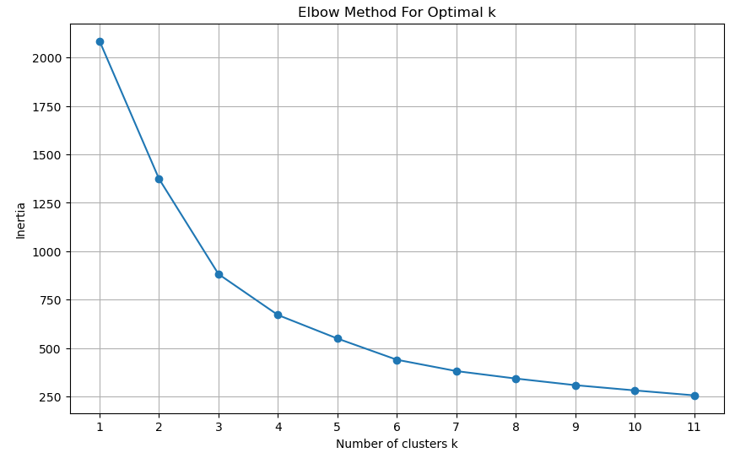
KMeans
Elbow method to find the optimal k, however there is no clear elbow visible.
Therefore, there will not be any evaluating of the optimal k with the elbow method.

Slide 14
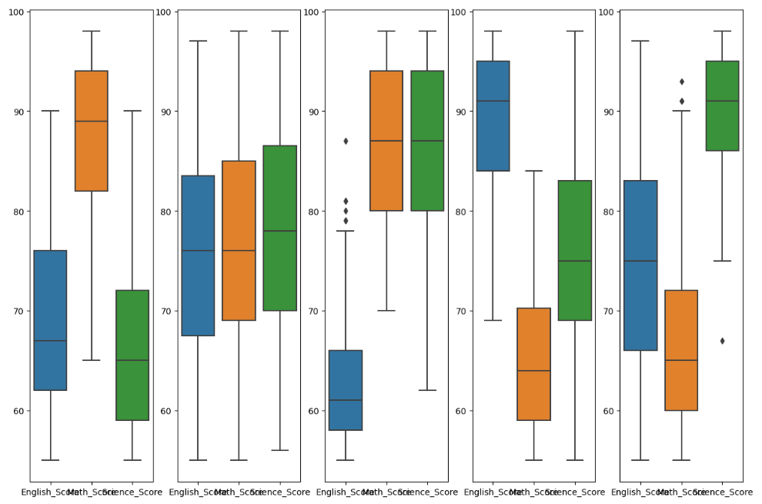
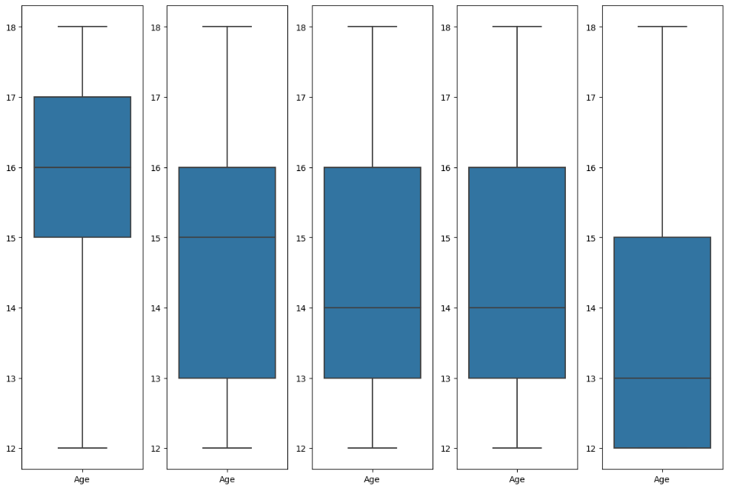
Clusters created by KMeans
Students with high Math score, low English & Science scores
Students with average English, Science and Math score
Students with high Science score and Math score, low English score
Students with high English and average Math score, low Science score
Students with high Science score, average English score and low Math score

Slide 15
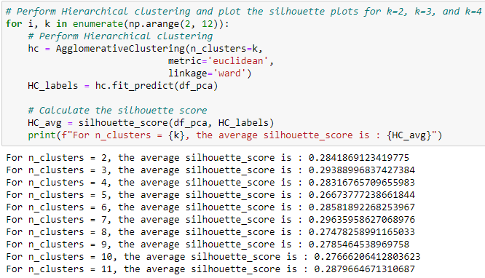
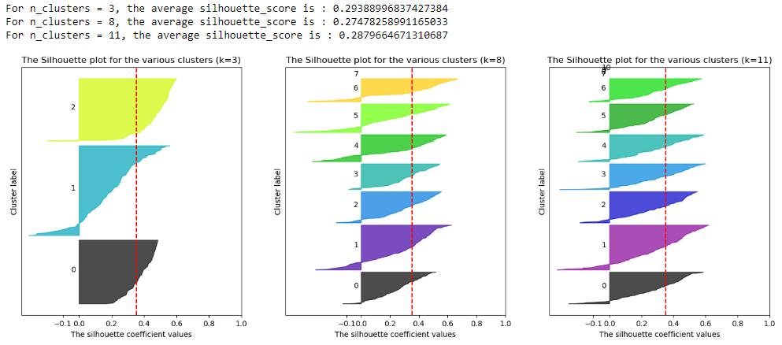
Hierarchical Clustering
Highest Average Silhouette score for Hierarchical Clustering:
0.284 with 2 clusters
Visualizing the silhouette plots for the top 3 silhouette scores

Slide 16
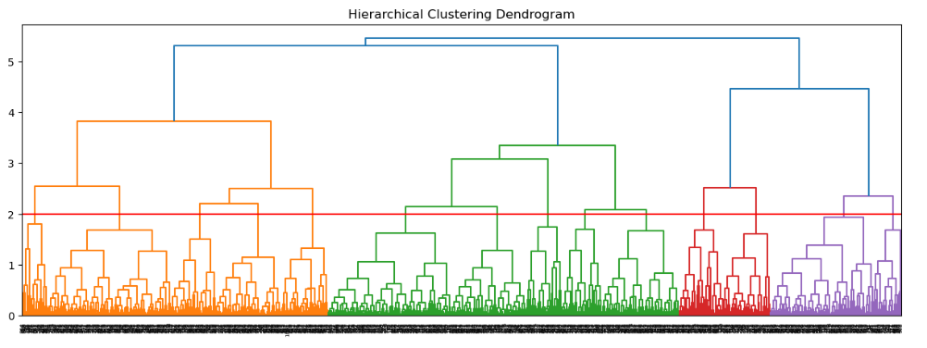
Hierarchical Clustering (Dendrogram)
From the dendrogram, it can identify 14 groups separated by the Hierarchal Clustering Model (Agglomerative Clustering).

Slide 17
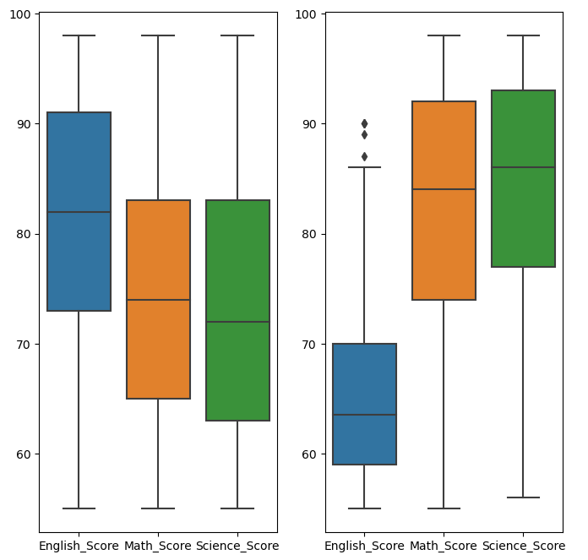
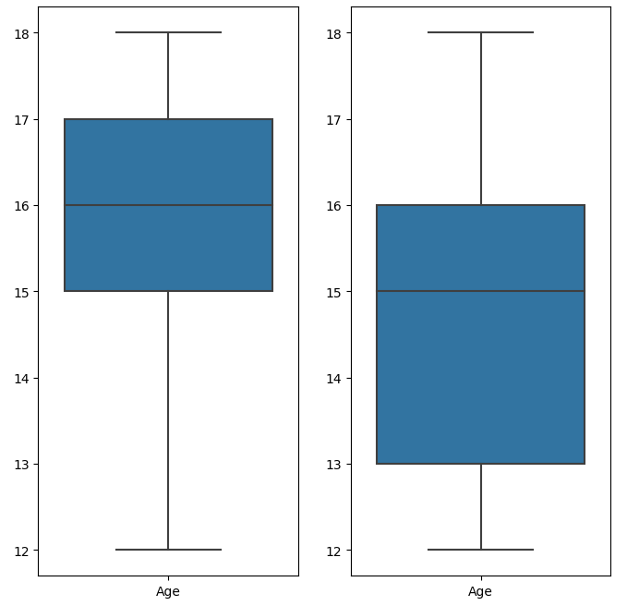
Clusters created by Hierarchical Clustering
Students with average English, Math and Science scores
Students with average Math and Science scores, low English score

Slide 18
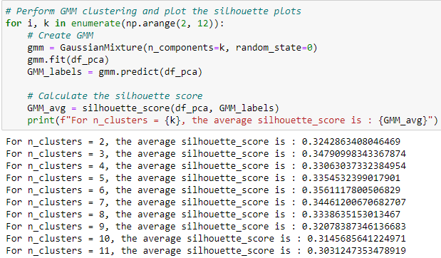
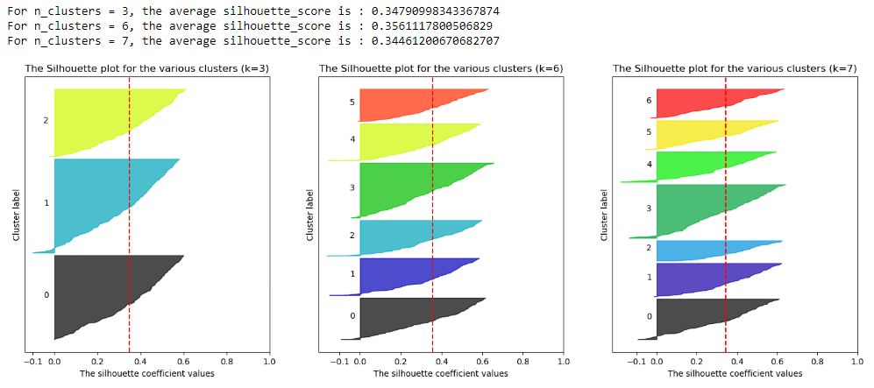
GMM Clustering
Highest Average Silhouette score for GMM Clustering:
0.355 with 6 clusters
Visualizing the silhouette plots for the top 3 silhouette scores

Slide 19
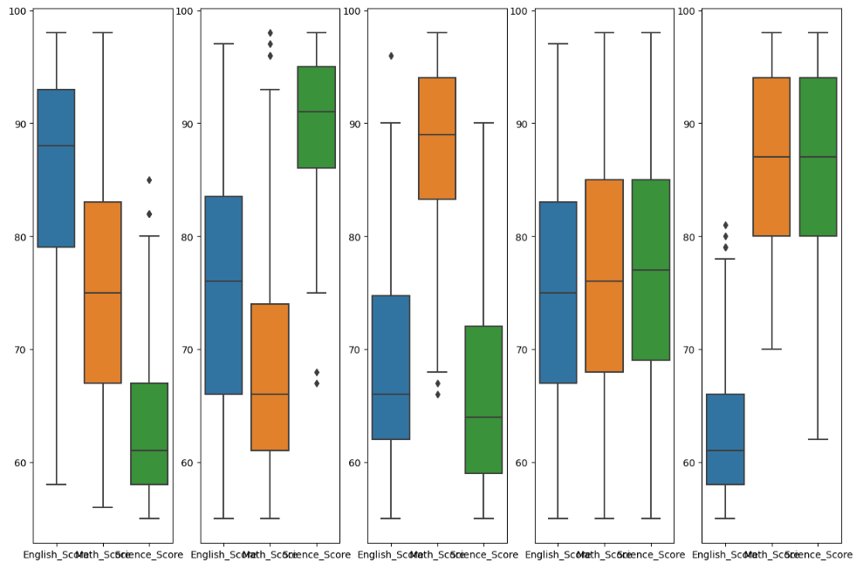
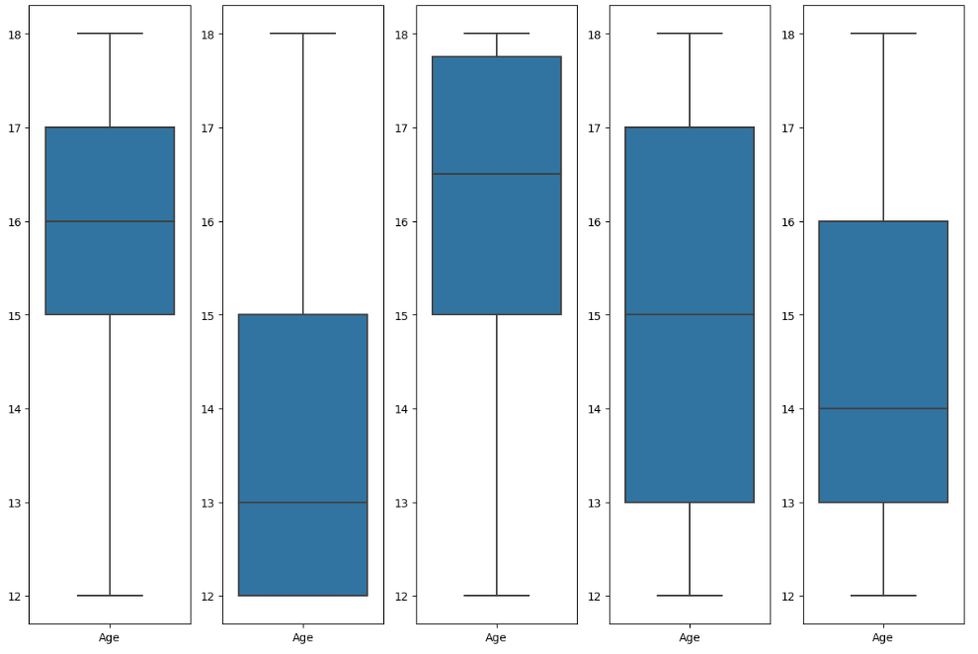
Clusters created by GMM Clustering
Students with high English score, average Math, low Science scores
Students with high Science score, average English & Math score
Students with high Math score, average Science & English scores
Students with average Math, Science and English scores
Students with high English & Science scores, low English score

Slide 20
Conclusion
Models ranking:
KMeans Clustering
0.356 silhouette score with 6 clusters
GMM Clustering
0.355 silhouette score with 6 clusters
Hierarchical Clustering
0.293 silhouette score with 2 clusters
These models have their own ways on how they segment the students.
These models segment the clusters by the students’ scores.

